Slide 1
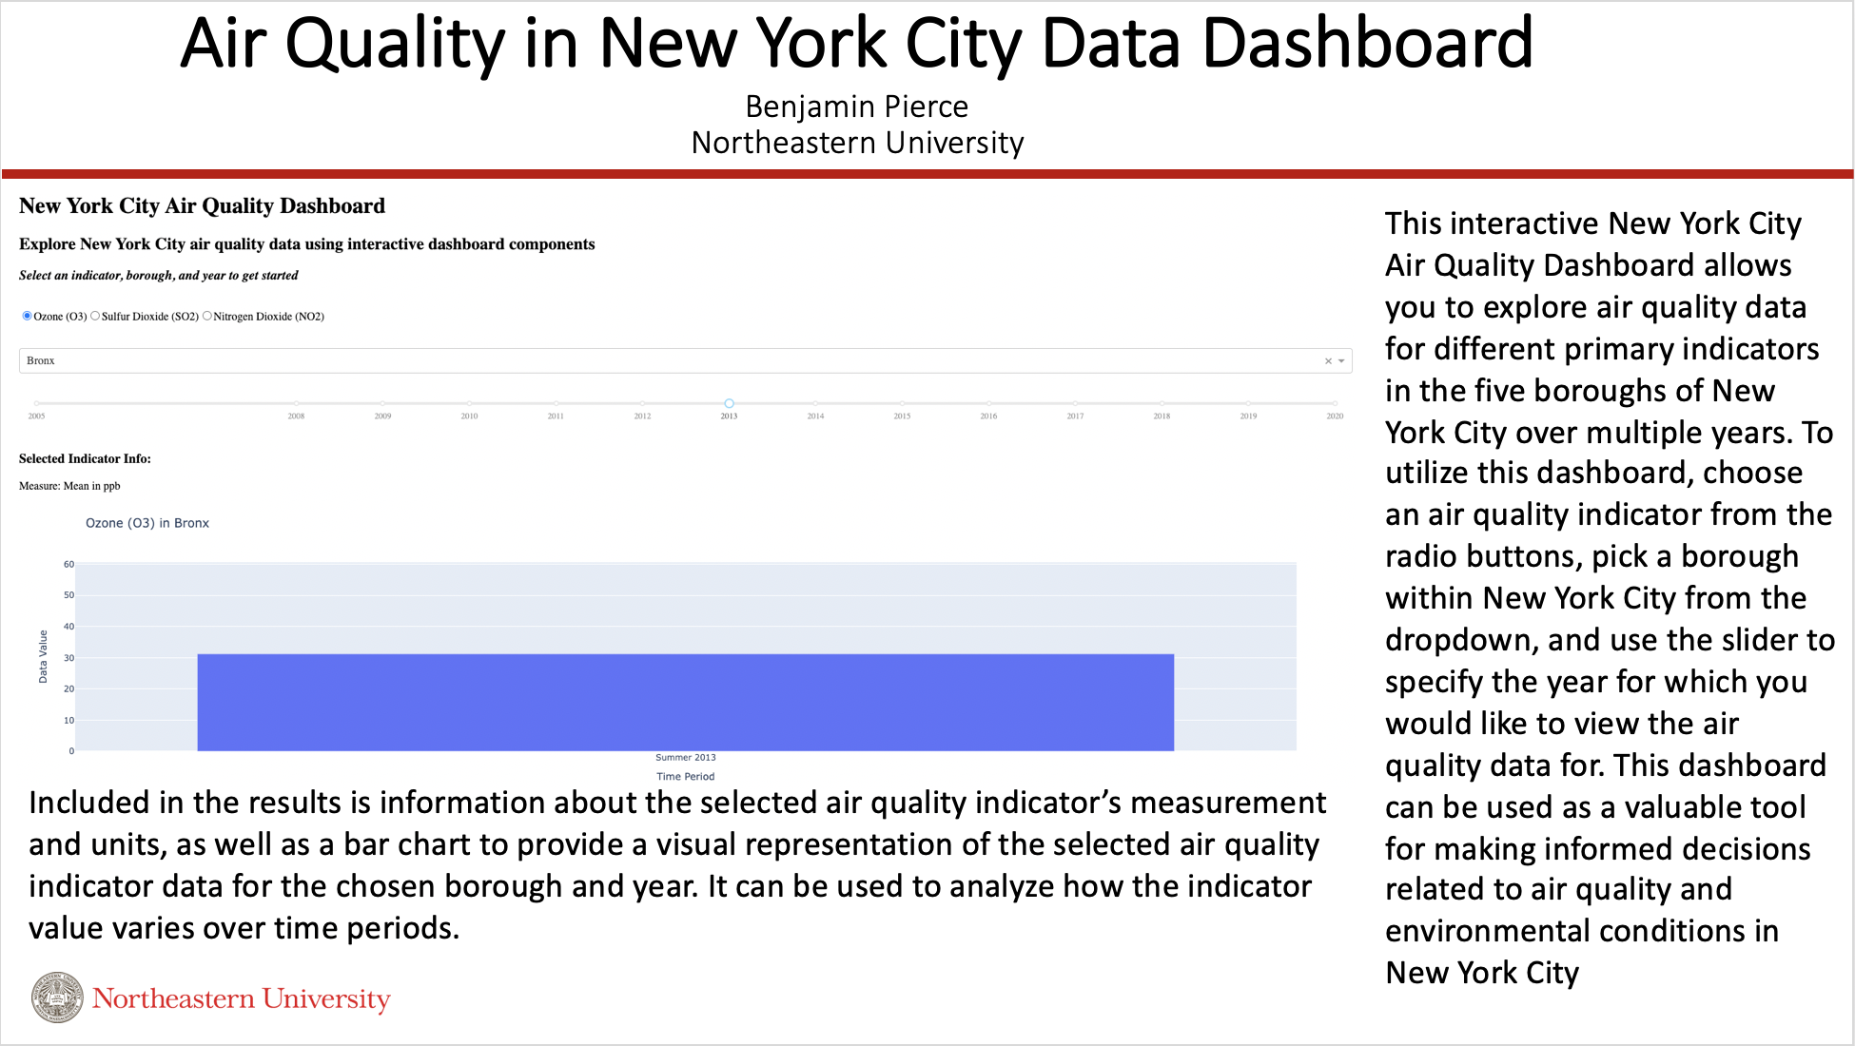
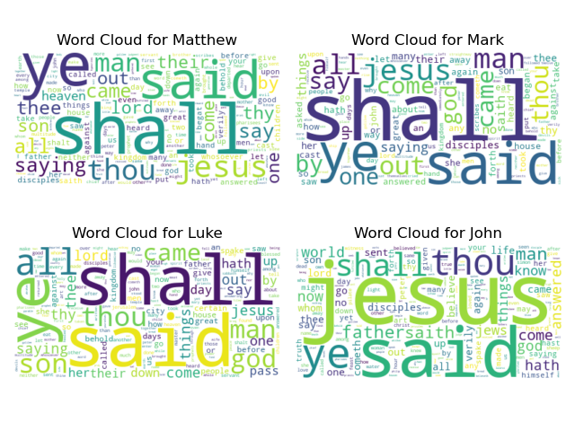
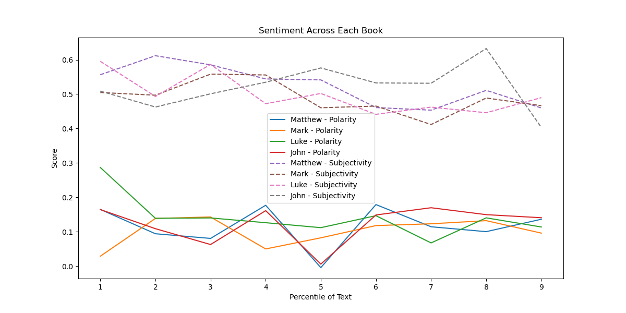
ScriptScript - A Comparative Text Analysis Library
Benjamin Pierce
Data Source: King James Bible
Sentiment Over the Course of Each Book
Showcases subjectivity and polarity over time in the same visualization
All maintain a subjectivity of ~0.5 to 0.6 over course of text
Mildly subjective, makes sense in religious context
All showcase varying degrees of lower, positive polarity
Positive neutrality
Slight differences attributed to varied audiences and interpretations
WordCloud Subplots
Show relatively similar distributions of most frequently used words
“Shall” emphasized more in Matthew, Mark, Luke
“Jesus” used much more frequently in John
Discrepancies in distribution due to different audiences/interpretations

